Slide 1
AI and the Arabidopsis thaliana Technological solutions meet nature-based problems
Daria Elena Vlăduțu
Notes:
2 MINUTES

Slide 2
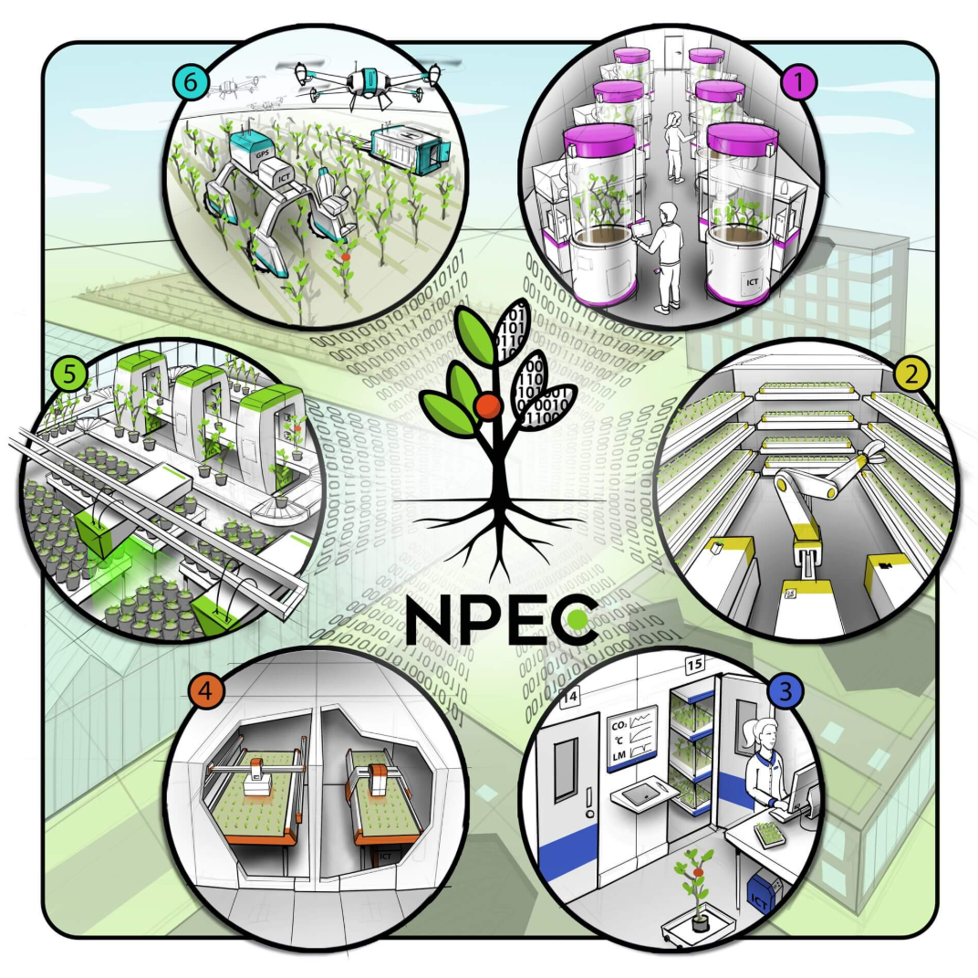
Agenda
Problem definition
Solution Overview
Results and Evaluation
Error Analysis and Iteration
Assumptions
Limitations
Next steps…

Slide 3
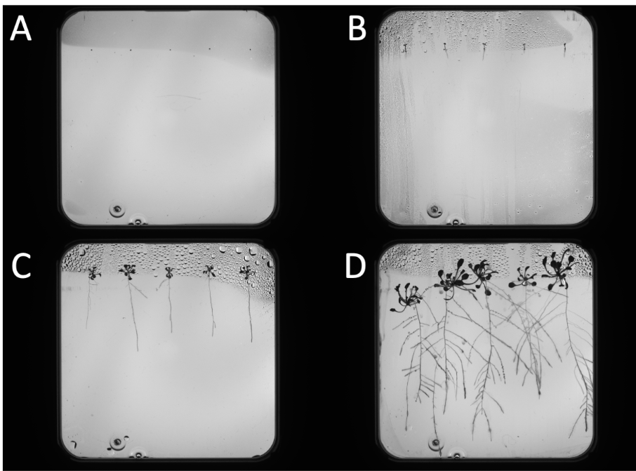
Problem definition
The challenge
Analyses of plant root images and physical interaction are manual, time-consuming, and potential sources of human error.
Core tasks
Image Analysis
Robotic Action
Client objectives
Automated analysis of plant root systems and robotic inoculation of plants
Arabidopsis thaliana
(From A to D): Seeds germinate, revealing roots, hypocotyl, and leaves. Lateral roots sprout from the primary, and they begin to crisscross
Notes:
Main scope: plant phenotyping
Centered around Hades
First part: CV -> raw images of Arabidopsis and accurately predict roots
Second part: Robotics
Seamlessly integrate these parts to create a system that takes root coords and directy feeds them to the robotic controller.

Slide 4
Solution overview
Integrating computer vision and robotics into an end-to-end inoculation pipeline

Slide 5
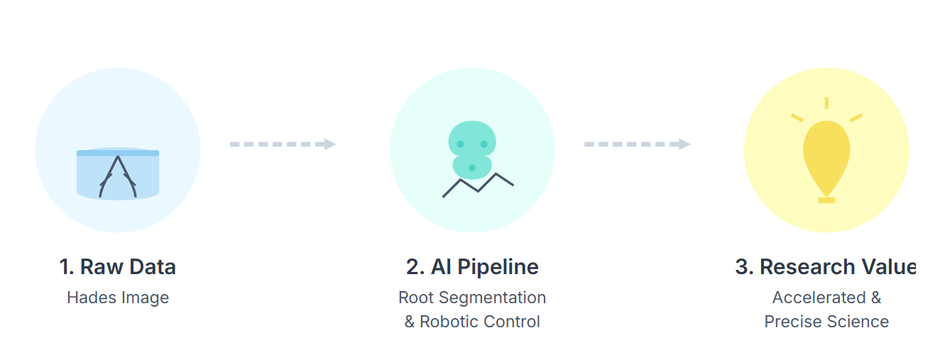
How my solution creates client value
Directly accelerating plant science research
High-Throughput Analysis
Enhanced Experimental Precision
Notes:
Manual labour & Human inconsistency
Increase scale and speed of experiments
Level of precision and consistency
Accelerating pace of discovery

Slide 6
Results & Evaluation

Slide 7
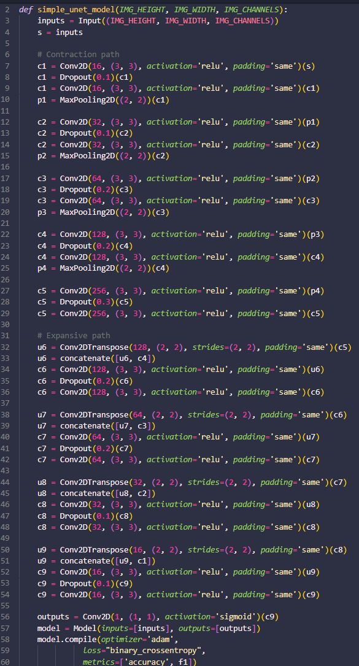
Final model Stats for nerds
Custom U-net model
Patch size: 256 x 256
Step size: 128
Batch size of 32
Loss function: binary_crossentropy
Early stopping triggered at epoch 18/30
Val_f1: 0.8374
sMAPE: 6.073
U-Net: Convolutional Networks for Biomedical Image Segmentation (Ronneberger et. Al, 2015)
Notes:
The final model selected for the pipeline is a custom U-net model
Trained on patchified dataset
Val_f1 of 0.837 -> model is both precise and comprehensive at identifying root pixels
It does not wildly guess or missing large sections of the roots
SMAPE -> 6% different from true length
For a biological measurement -> demonstrates success of the entire pipeline

Slide 8
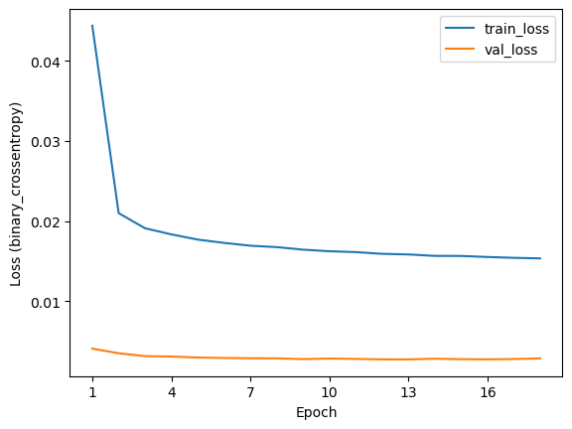
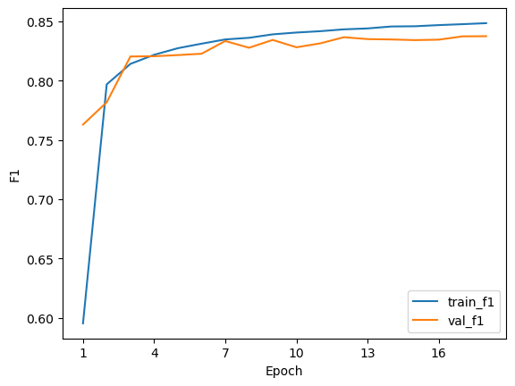
Final model Stats for nerds
Notes:
Loss Curve:
Both the training and validation loss decrease rapidly and then flatten out.
Crucially, the validation loss stays low and doesn't start creeping up.
This is the classic sign of a well-generalized model that is not overfitting.
F1 Curve:
This mirrors the loss curve.
Both training and validation F1 scores shoot up quickly and then plateau at a high level.
The fact that the val_f1 is so close to the train_f1 confirms that the model performs almost as well on data it has never seen as it does on the data it was trained on.

Slide 9
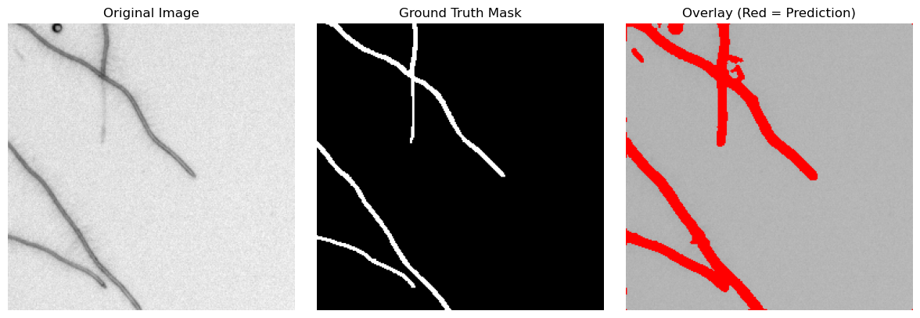
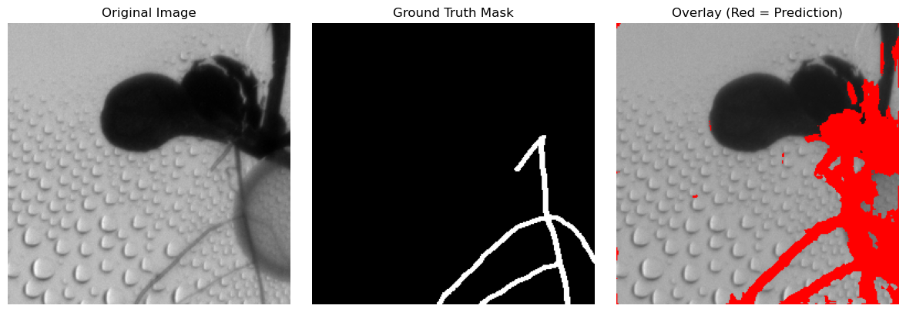
Predictions (with overlay)
Notes:
The model covers ground truths very well, especially for the main, thicker parts of the root.

Slide 10
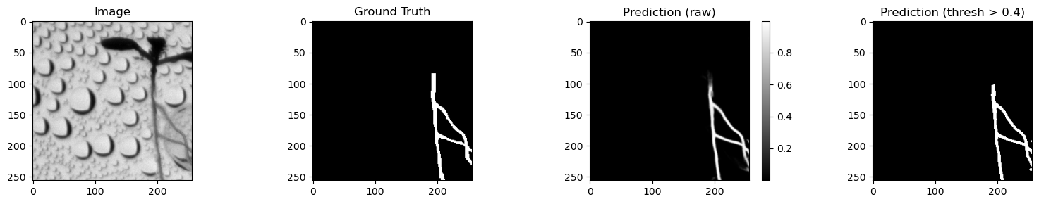
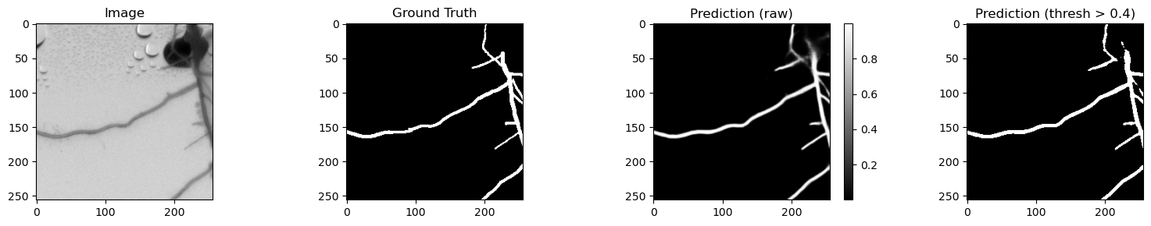
Predictions (raw)
Notes:
Examples of raw predictions.

Slide 11
Strategy for main pipeline
Data Pre-processing & Inference
Images are padded, cropped, and patchified.
Model Prediction
Unpatch, unpad, uncrop to full mask
Post-processing
Thresholding at 0.10 to binarize masks
Area filtering (min_area =150px)
Top & Petri dish crop: removed 15% of top image and cropped to Petri dish size
Main root components
Aspect ratio threshold; min 1.5
Vertical start: max 30%
Threshold of 200px for large components
Main root components
Skeltonize
Function evaluates all possible paths between root tips
Scoring for each path
Notes:
Preprocessing:
Padding + cropped + patchified
Model predicts
Mask is reconstructed
Post-processing:
Thresholding of 0.1 to binarize masks
Masks are refined by filtering out components
Next cropping sequence
Find main root component:
Image is segmented into 5 regions
Keep objects w aspect ratio >= 1.5
Valid starting zone : top 30% of the image
Filter objects lower than 200px
Extract main root:
Skeletonize images
Function evaluates all possible paths between root tips
Score

Slide 12
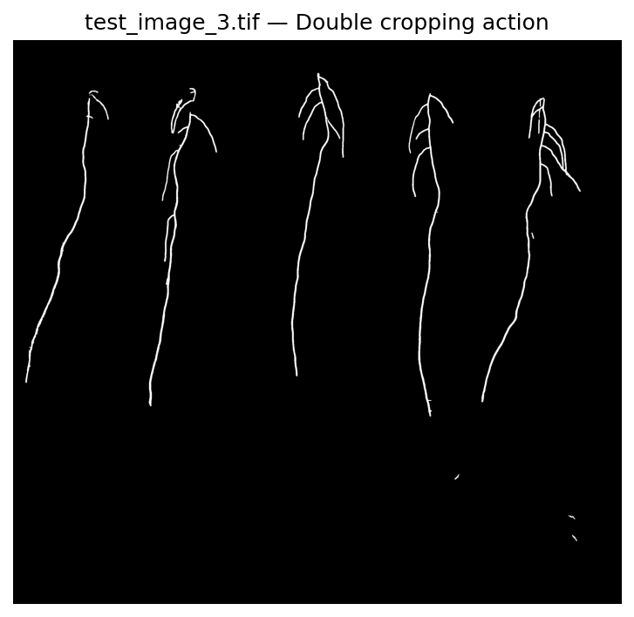
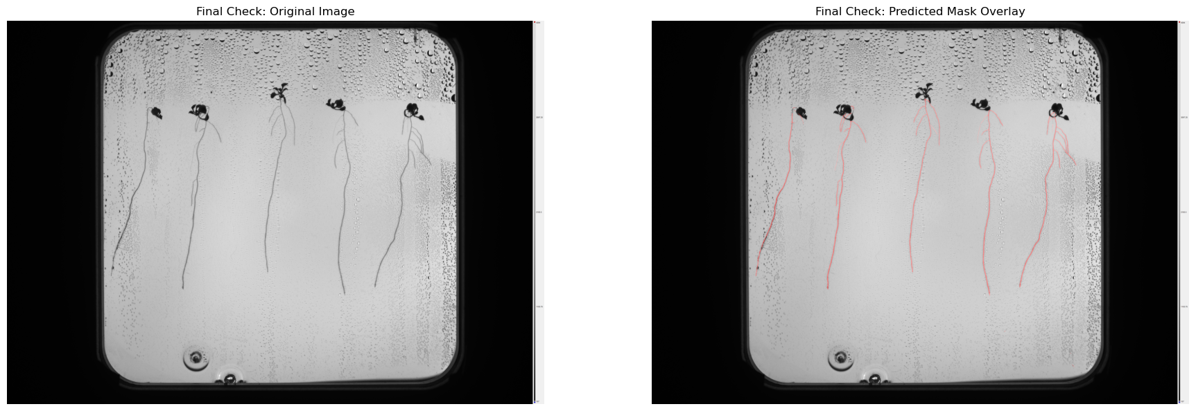
Notes:
Talk a bit here as well.

Slide 13
Error analysis & Iterations

Slide 14
Iteration 1: Experimenting with datasets
Clean dataset
Merged Y2B_23 & Y2B_24
Removed non-root masks + unpaired images
Simple filtered dataset
Kept root-rich patches (min 0.5% of patch must be root)
Patch includes at least one connected root segment > 75px
Automated tuning dataset
Tuner finds the best min_ratio and min_area, using optuna.
Based on initial dataset
Augmented dataset
Applied to the tuned dataset
Horizontal + vertical flip
Random rotate 90
Shift scale rotate
Random brightness contrast
Balanced dataset
Used logic of tuning from automatic tuning dataset
Added more background patches
Notes:
The cleaned dataset was created by simply processing and splitting the original datasets into training, testing, and validation sets. Images were cropped according to petri dish dimensions, padded to be divisible by patch size of 256, then they were patchified. When training this dataset received a val_f1 of 0.78.
The simple_filtered_dataset was created on top of the original one, by filtering out the patches that contain at least 0.05% of root data, and included at least one connected root segment larger than 75px. Val_f1 mentioned previously.
The automated_tuning dataset was created using an automated hyperparameter searcher. The tuner finds the best minimum proportion of root pixels per patch and the minimum pixel size of a connected root blob. For each combination of parameters, it loops through the mask patches, checks if the connected blobs are larger than the min_area, checks if the patch touches the border of the original image, and decides to keep the patch based on the min_ratio. Val_f1 of 0.81
The augmented_dataset was built upon the automated_tuning dataset and it contains 2 augmentations per mask, such as horizontal, verical flips; random rotations to 90 degrees, shifts, scales, and random brightness contrast. Val_f1 of 0.52
The balanced_dataset was created due to the realisation that the augmented _dataset did not have enough background patches. I balanced it partially by having 1 background patch per 2 root-rich patches. The dataset was built with the logic from the automated_dataset.

Slide 15
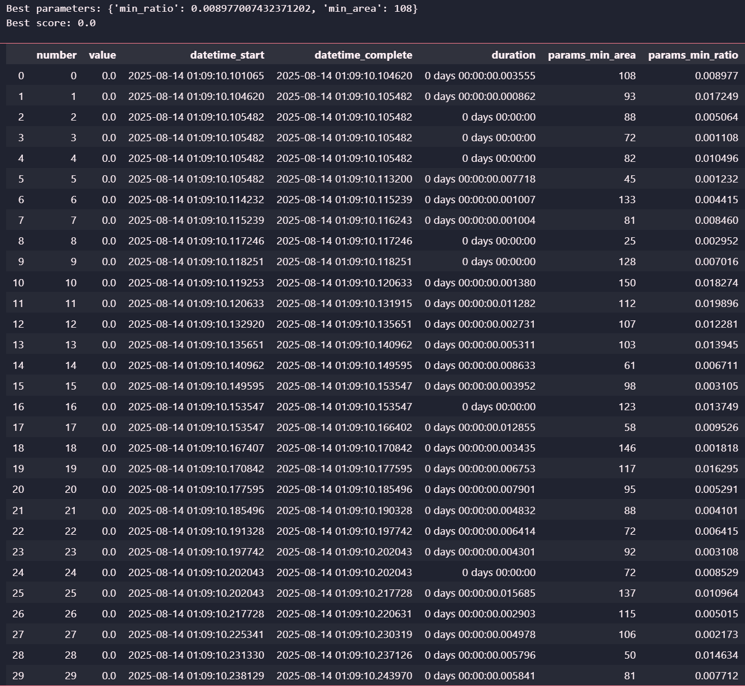
Iteration 1: Experimenting with datasets
Notes:
How optuna finds the best min_area and min_ratio (30 trials).

Slide 16
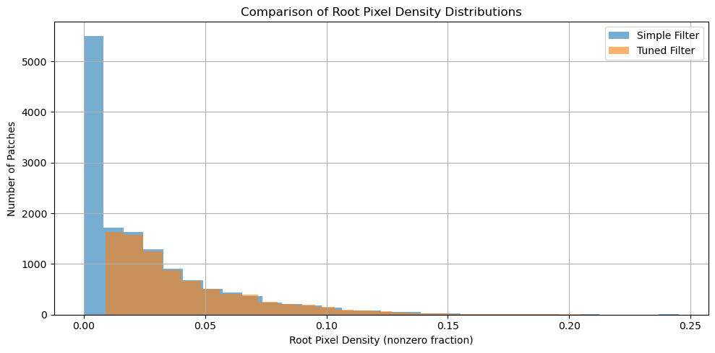
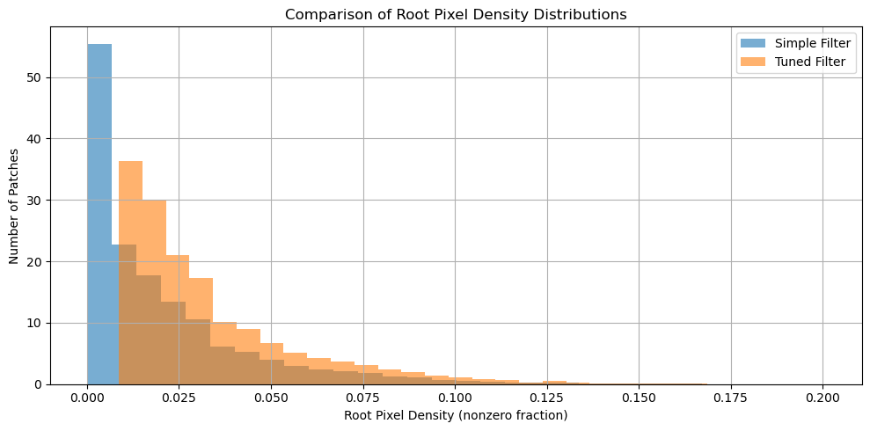
Iteration 1: Experimenting with datasets
2023 dataset
2024 dataset
Mean density (simple): 0.0251
Mean density (tuned) : 0.0409
Mean density (simple): 0.0198
Mean density (tuned) : 0.0329
Notes:
The tuned filtering approach for the 2023 dataset, the tuned filter creates a smaller, more focused dataset by effectively discarding near-empty patches.
For the 2024 dataset, the filter selected a more broader and evenly distributed range of patches.

Slide 17
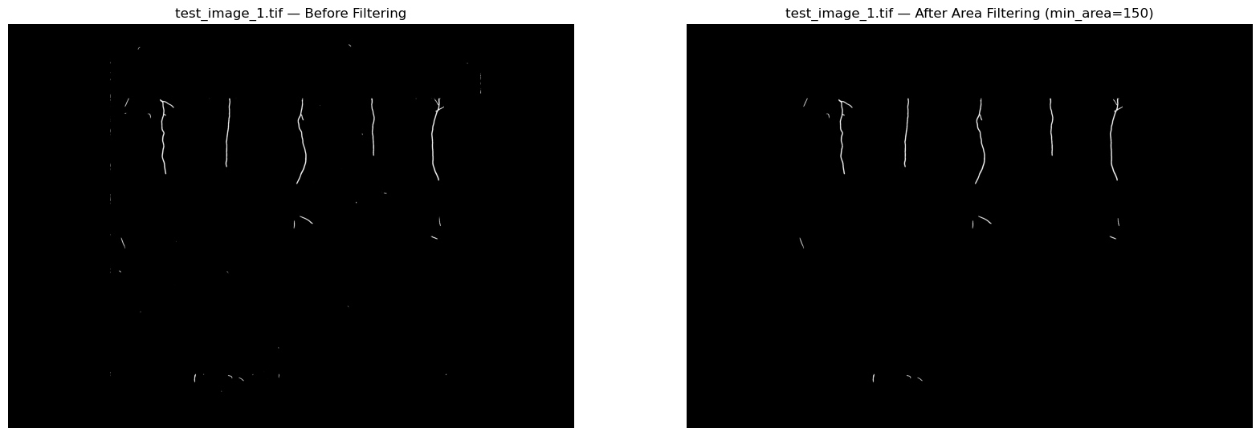
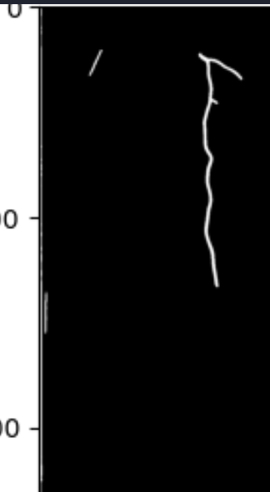


Iteration 2: Post-processing of masks
Issue: Salt-and-pepper noise
Initial solution: Morphological closing
Final solution: Filtering by area
Issue: First plant was being mistaken for a thin white line along the edge
Initial solution: Use a circular crop
Final solution: Have a ‘tighter’ crop
Issue: Newly germinated seeds were being missed entirely.
Solution: Lower filtering threshold from 250px to 50px
Notes:
When processing the masks post predictions, I encountered multiple problems. The first issue was salt-and-pepper noise. My initial solution for this issue was usng morpological closing (dilation + erosion) to get rid of the specks, but this had barely any effect. Therefore, I decided to implement a function that filters out components that were lower than a specified minimum. For the final pipeline, this threshold was 150px, but in other trials I had to set it to 200px.
Another problem I encountered was having the first plant be mistaken for a thin white line along the edge. Initially, I thought using a circular crop instead of a square one would solve the issue. (Circular cropping means that a circular mask that fits the object is created. Then the algorithm uses the mask to make everythink outside the circle transparent, and then it draws a simple square bounding box around the remaining circular crop.) I quickly realised, however, that having a ‘tighter’ crop which introduces a small inward padding, right after finding the bounding box, would be better.
Additionally, I had another problem where newly germinated seeds were being missed entirely. This issue raised from the way the masks were being segmented, where the minimum area threshold was 250 px at first, meaning any object below that was ignored. The fix was to lower this threshold to 50px.

Slide 18
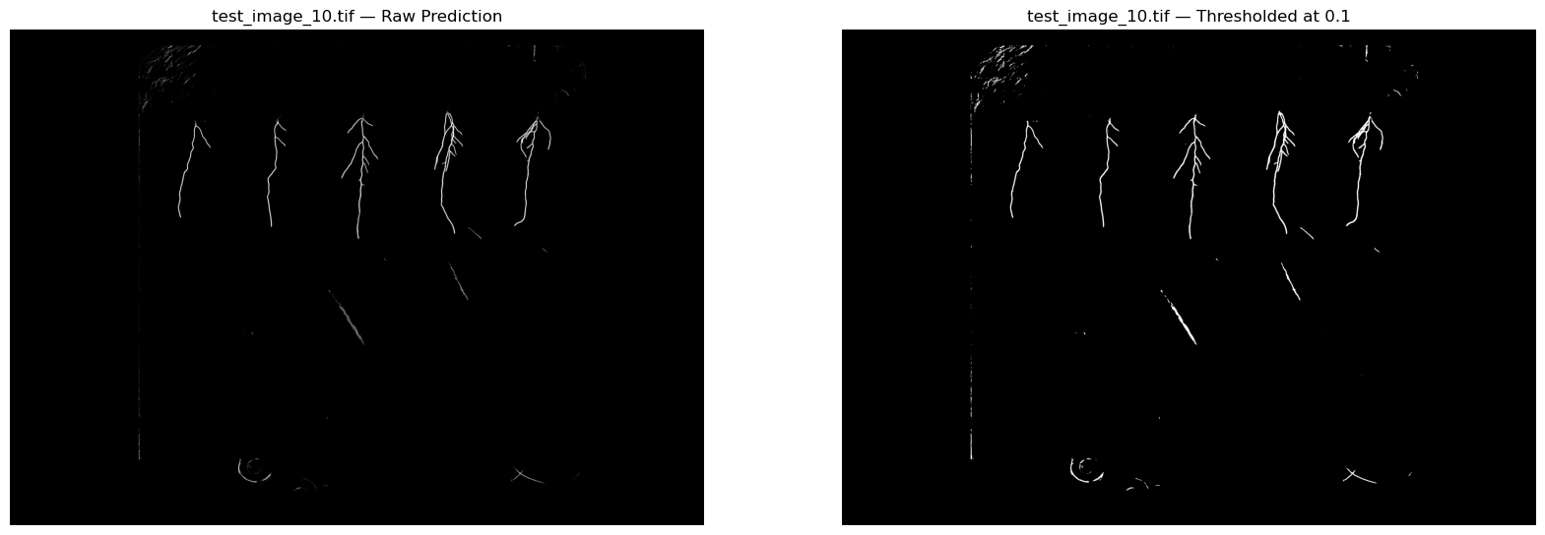
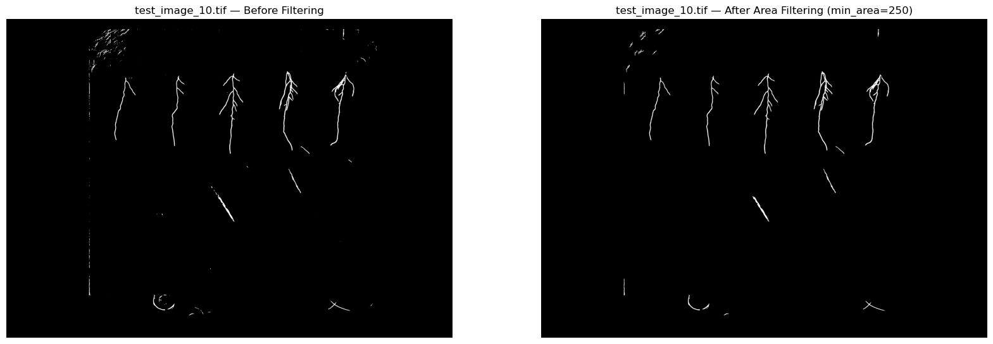
Iteration 2: Post-processing of masks Examples from another trial
Notes:
Example of prediction using model trained on tuned_dataset and using a higher component filtering.

Slide 19
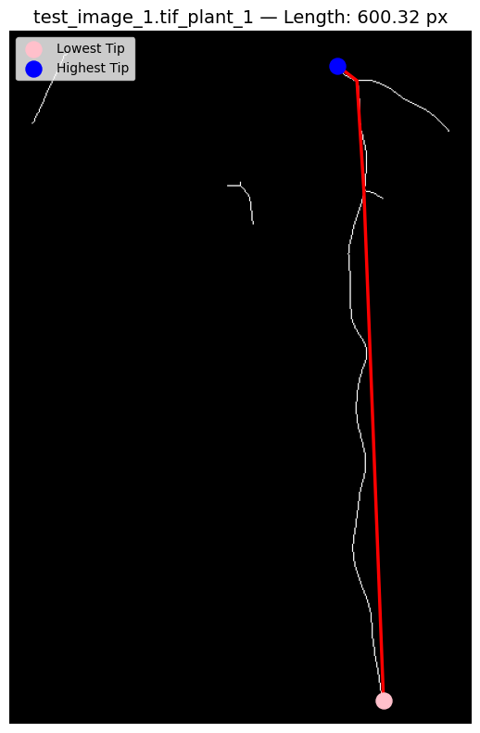
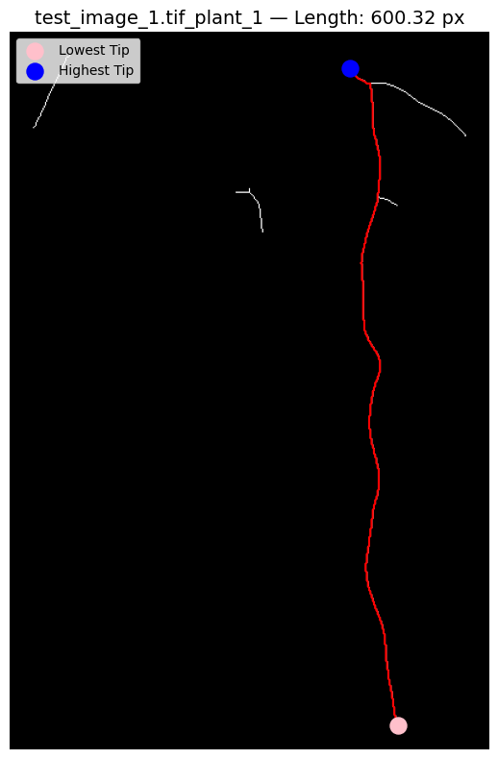
Iteration 3: Root length estimation
Issue: Find the primary root length
Initial solution: Scoring system between top/bottom tip nodes length, verticality and centrality.
Proposed solution: The A-star search
Notes:
The first method implied skeletonizing the mask, converting it into a mathematical graph structure where branches are edges and junctions are nodes. It returns the primary root path as previously mentioned.
The problem was that this approach was "greedy." It didn't have a strong sense of direction. If a long, complex side branch happened to end up as the lowest point, the algorithm would mistakenly trace that path.
The new method using the A-star algorithm uses a heuristic—an educated guess—to guide its search.
It constantly estimates the straight-line distance to the goal, which makes it heavily favor paths that are making direct, downward progress.
This prevents it from getting distracted by side branches and is a much more reliable way to identify the true primary root.
Now the results are actually very similar, but the visualisations are nicer.

Slide 20
Robotics

Slide 21
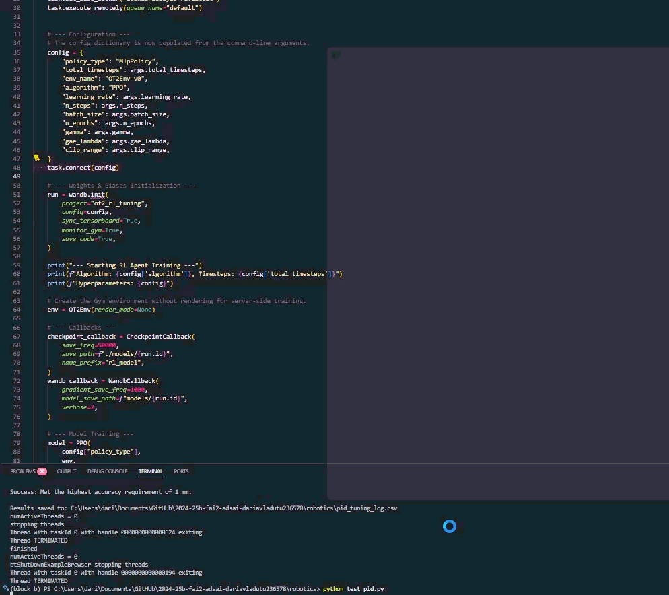
PID controller:
Best gains:
KP = 5.0
KI = 0.5
KD = 2.0
Final error: 0.592mm
Reinforcement learning journey:
4 official iterations
Continuous experimentation
Final error of RL agent: 9.2mm
Notes:
Pid:
KP: proportional
The Proportional term reacts to the current error. It's the primary force of the controller
KI: Integral
The Integral term looks at the accumulation of past errors. Its job is to eliminate small, persistent errors that the proportional term alone can't fix (this is called steady-state error).
KD: derivative
The Derivative term looks at the rate of change of the error. It predicts the future error and acts as a brake or damper to prevent the controller from overshooting the target.
RL AGENT: Played around with the learning rate (0.003->0.001), number of steps (2048->4096), making the reward function more agressive from 150 to 200.

Slide 22
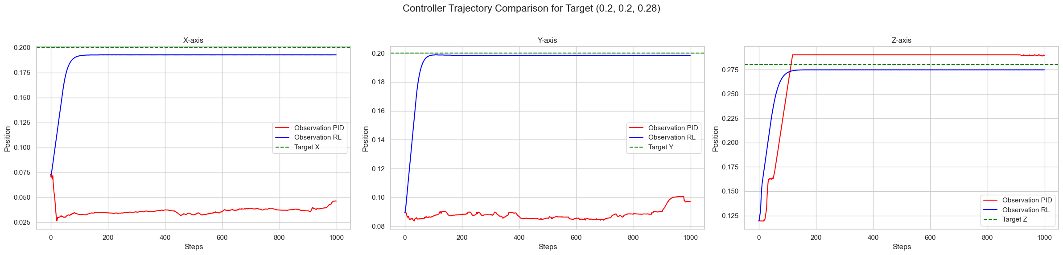
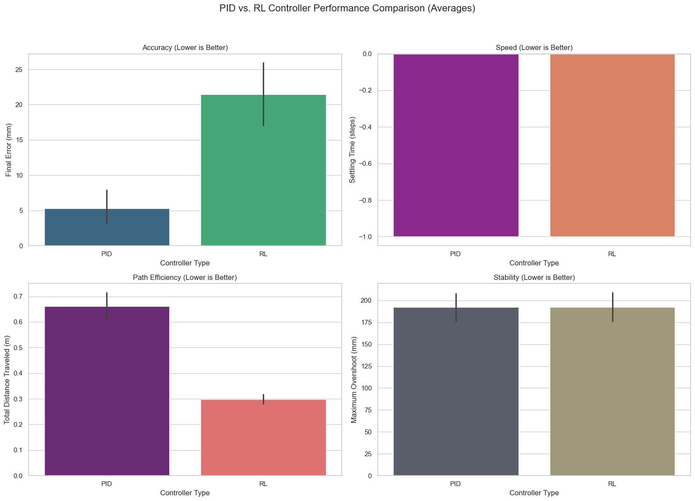
Notes:
Pid:
KP: proportional
The Proportional term reacts to the current error. It's the primary force of the controller
KI: Integral
The Integral term looks at the accumulation of past errors. Its job is to eliminate small, persistent errors that the proportional term alone can't fix (this is called steady-state error).
KD: derivative
The Derivative term looks at the rate of change of the error. It predicts the future error and acts as a brake or damper to prevent the controller from overshooting the target.
RL AGENT: Played around with the learning rate (0.003->0.001), number of steps (2048->4096), making the reward function more agressive from 150 to 200.

Slide 23
Assumptions

Slide 24
Assumptions made during the design of the pipeline
Top 15% of image height is not useful data
Components with an area < 150px are noise
Roots are objects that are tall and skinny (area ratio threshold > 1.5)
The primary root is the shortest path from the topmost to bottommost node
Notes:
These are the assumptions made during the making of the final computer vision pipeline.

Slide 25
Limitations

Slide 26
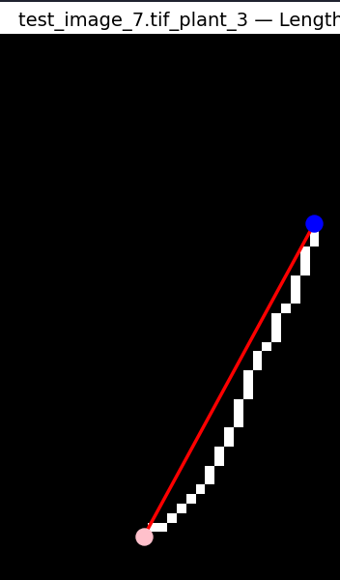
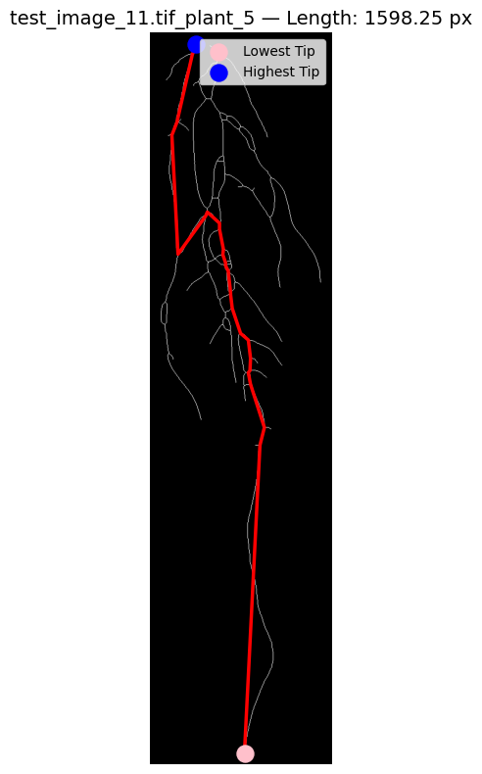
Dataset limitations
Model cannot properly detect smaller roots
Overlapping and dense roots make it hard for the model to identify the main root path accurately
Notes:
My model has two main limitations. First, as you can see here, it struggles with very small, newly germinated roots. In the example image here, it only detected a speck as a root. Second, in very dense and overlapping root systems, identifying the single primary root becomes challenging, and it goes along with the first longest skeleton it can find, if they are separated.
The limitation that deserves to be mentioned here is the data one, as the datasets did not have a lot of diverse data or better annotated data to produce higher quality results.

Slide 27
Next steps

Slide 28
What can be done?
1 A faster, more computationally proficient computer to train a model, using a mega dataset.
2 A dataset containing more newly germinated seeds.
3 A dataset containing manually annotated main roots
Notes:
We could get even better results with a better trained model. If the datasets would contain more data, than a model trained for even longer could produce better results.

Slide 29
Thank you

